Slide 1

Database Principles:
Fundamentals of Design, Implementation, and Management
Tenth Edition
Chapter 7
Data Modeling with Entity Relationship Diagrams

Slide 2
Objectives
In this chapter, students will learn:
  The main characteristics of entity relationship components
  How relationships between entities are defined, refined, and incorporated into the database design process
  How ERD components affect database design and implementation

Slide 3
The Entity Relationship Model (ERM)
ER model forms the basis of an ER diagram
ERD represents conceptual database as viewed by end user
ERDs depict database’s main components:
  Entities
  Attributes
  Relationships

Slide 4
Entities
Refers to entity set and not to single entity occurrence
Corresponds to table and not to row in relational environment
In Chen and Crow’s Foot models, entity is represented by rectangle with entity’s name
The entity name, a noun, is written in capital letters

Slide 5
Entities
Represented as a rectangle in E-R diagram
Example:
Student
Notes:
Lecture 1
5

Slide 6

Attributes
Characteristics of entities
Chen notation: attributes represented by ovals connected to entity rectangle with a line
  Each oval contains the name of attribute it represents
Crow’s Foot notation: attributes written in attribute box below entity rectangle

Slide 7
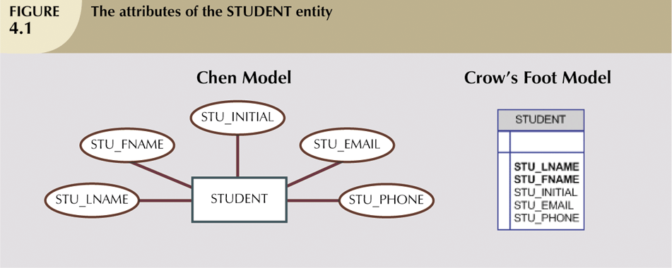
Attributes
Example
Notes:
Lecture 1

Slide 8
Attribute Types
Simple/Atomic or Composite (number of sub-parts):
Simple: one part
Composite: divided into sub-parts
e.g. Name = surname + first_name
Single- or multi-valued (number of values per entity):
Single-valued: one value for a particular entity
Multi-valued: a set of values
e.g. Student has a number of courses
Null attributes: unknown, not applicable or missing
Derived / Calculated: values of attributes can be derived from other attributes (not stored; computed when required)
e.g: age from DOB
Notes:
Lecture 1
7

Slide 9
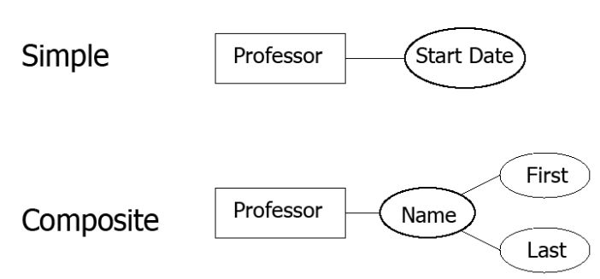
Attributes (cont’d.)
Composite attribute can be subdivided
Simple attribute cannot be subdivided

Slide 10
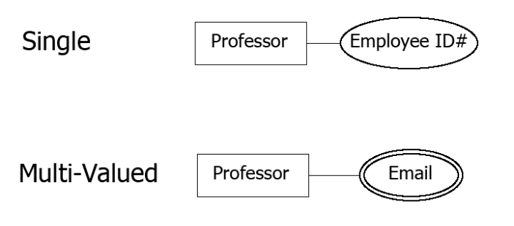
Attributes (cont’d.)
Single-value attribute can have only a single value
Multivalued attributes can have many values

Slide 11
Attribute Types (continued)
NULL attributes have no value
– not 0 (zero)
– not a blank string
Attributes can be “nullable” where a null value is
allowed, or “not nullable” where they must have a value.
Represented by:
Notes:
Lecture 1

Slide 12
Attributes (cont’d.)
Derived / Calculated Attributes:
M:N relationships and multivalued attributes should not be implemented
  Create several new attributes for each of the original multivalued attributes’ components
  Create new entity composed of original multivalued attributes’ components
Derived attribute: value may be calculated from other attributes
  Need not be physically stored within database

Slide 13
Attribute Types (continued)
Years Teaching
Professor
Start_Date
Notes:
Lecture 1

Slide 14
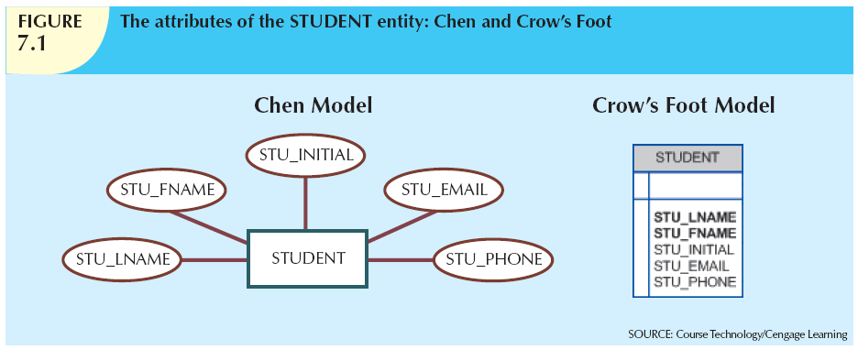

Slide 15
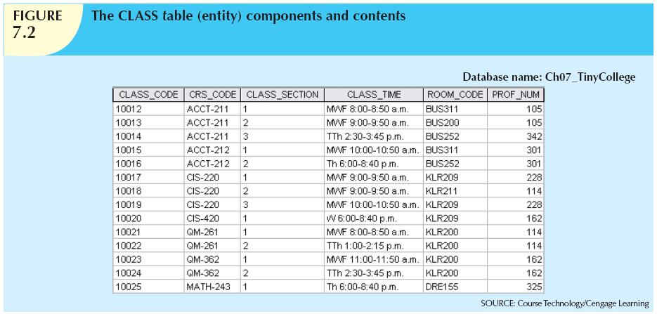

Slide 16
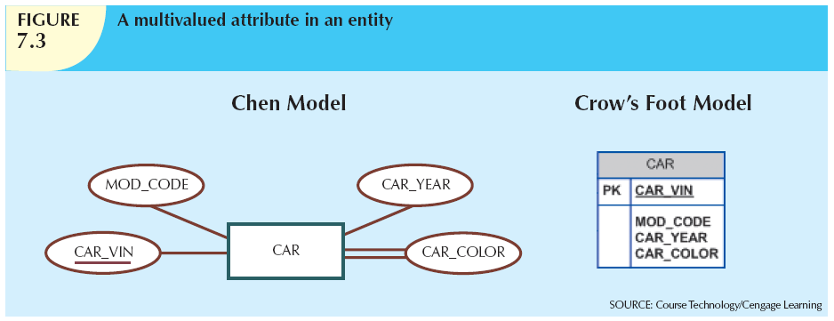

Slide 17
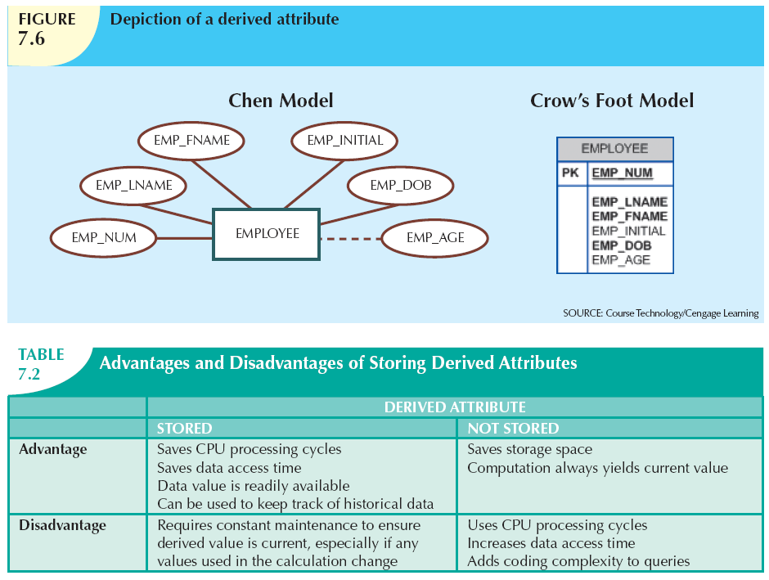

Slide 18
Relationships
Association between entities
Participants are entities that participate in a relationship
Relationships between entities always operate in both directions
Relationship can be classified as 1:M
Relationship classification is difficult to establish if only one side of the relationship is known
Represented by diamonds in E-R diagram

Slide 19
Connectivity and Cardinality
Connectivity
  Describes the relationship classification
Cardinality
  Expresses minimum and maximum number of entity occurrences associated with one occurrence of related entity
Established by very short statements known as business rules

Slide 20
Connectivity and Cardinality
Connectivity:
Used to describe the relationship classification
  one to one
  one to many
  many to one
  many to many
Notes:
Lecture 1

Slide 21
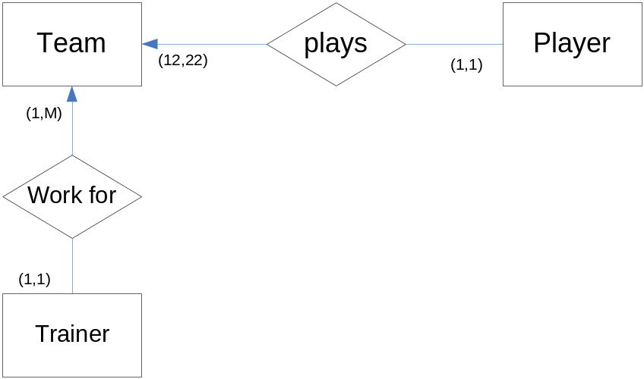
Connectivity and Cardinality
Cardinality
  Expresses minimum and maximum number of entity occurrences associated with one occurrence of related entity
Example:
Each team has one or more trainers.
Each team has at least 12 at most 22 players.
A player may play in only one team and a trainer may work for only one team.
Notes:
Lecture 1

Slide 22
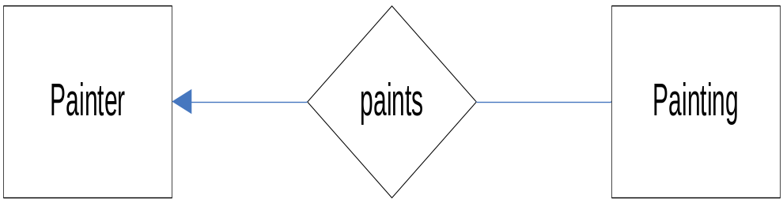


The Basic Chen ERD
A One-to-Many (1:M) Relationship:
A Painter can paint many Paintings;
Each Painting is painted by one Painter
A Many-to-Many (M:N) Relationship:
An Employee can learn many Skills;
each Skill can be learned by many Employees
A One-to-One (1:1) Relationship:
an Employee manages one Store;
each Store is managed by one Employee
Notes:
Lecture 1

Slide 23
Degree of Relationships
Degree of a relationship is the number of entity types that participate in it
  Unary Relationship
  Binary Relationship
  Ternary Relationship
Notes:
Lecture 1
10

Slide 24
Examples
Can have more than one relationship between entities.
starts at
Road
Town
ends at
Can have recursive (UNARY) relationships and can indicate roles for clarity.
manager
Employee
works for
worker
date
A relationship can also have descriptive attributes.
Client
orders
Book
Notes:
Lecture 1
9

Slide 25
Ternary Relationship
proj_name
Name
Project
Hires
Contractor
location
Address
budget
end_date
start_date
end_date
Contract
number
start_date
value
Notes:
Lecture 1
10

Slide 26
Keys in E/R Diagrams
Identifiers: one or more attributes that uniquely identify each entity instance
Composite identifier: primary key composed of more than one attribute
Identifiers (Primary Key ) must be underlined!!!!
Notes:
Lecture 1

Slide 27
E-R Diagram Symbols
Entity Set
Relationship
Weak Entity
Set
One-to-one link
Many-to-one link
Attribute
Many-to-many link
number
Key Attribute
Multivalued
Attribute
Attribute can be
NULL
Derived Attribute
Notes:
Lecture 1

Slide 28
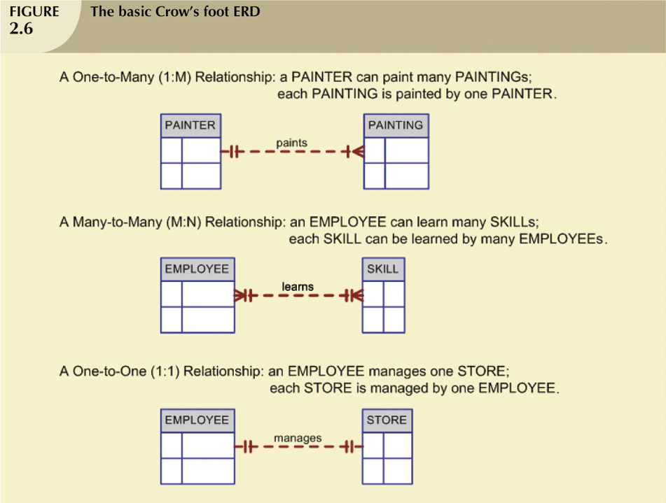
The Entity Relationship Data Model –Extra Information
Notes:
Lecture 1

Slide 29
The Object Oriented Model
Modeled both data and their relationships in a single structure known as an object
Object-oriented data model (OODM) is the basis for the object-oriented database management system (OODBMS)
OODM is said to be a semantic data model
Object is an abstraction of a real-world entity
Attributes describe the properties of an object
Objects that share similar characteristics are grouped in classes
Classes are organized in a class hierarchy
Inheritance is the ability of an object within the class hierarchy to inherit the attributes and methods of classes above it
Notes:
Lecture 1

Slide 30
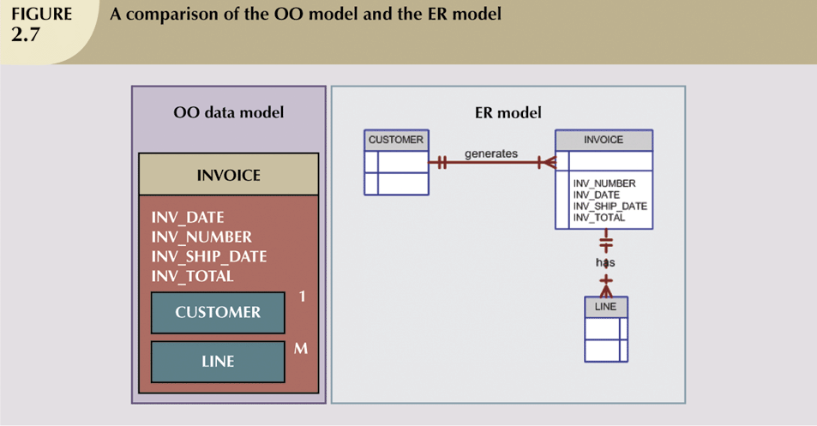
The Object Oriented Model (continued)
Notes:
Lecture 1

Slide 31
Developing an ER Diagram:
Practices
Exercise 1:
Draw an ERD for the following specification.
Student: id, name, dob
Department: dno, dname
Course: ccode, title, credits
Rules:
A student is enrolled in one department
In one department, there are many students.
A student takes many courses
A course is taken by many students.
A course is offered by one department
A department offers many courses.
Notes:
Lecture 1

Slide 32
Practices
Exercise 2:
There are many activities. Each activity has a name, a fee, a maximum capacity and number of types (such as tennis, swimming,baseball,etc...). A student may participate in many activities and there may be many students participating in each activity. A student has name (first_name, last_name), a cgpa, and a dob. Each activity is supervised by one and only one coach. But a coach may supervise many activities. Each coach has a name, an identity number and a salary.
Clearly indicate the Primary Keys.
Notes:
Lecture 1

Slide 33
Practices
Exercise 3:
Draw an ERD for the Moon Hotel. There are many rooms in the hotel. Each room has a unique room number, type and price. There may be many customers in each room. But a customer may rent only one room. Each customer has a unique customer_id, name, date of birth and a phone number. There are many departments in the hotel. For each department you need to store deptno, and name. Departments are identified by deptno. There are many employees working for a department, but an employee works for only one department. Each employee has an emp_id, name and salary. One of the employees is the manager of a department. An employee may serve many rooms but only one employee serves each room.
Notes:
Lecture 1

Slide 34
Practices
Exercise 4:
Draw Entity – Relationship Diagram for the following scenario:
There are many branches. Each branch has the following attributes (branchno, address, fax_no, telno). There are many employees. Each employee has the following attributes (name, address, position, salary, gender, empno). Name of an employee is structure that contains two fields (last_name, first_name), address of employee is also a structure that contains (no, street, city). In each branch there are many employees working. Each employee works for a single branch. Each branch is managed by one and only one employee. And each employee manages one and only one branch.
Clearly indicate the Primary Keys.

Slide 35
Practices
Exercise 5:
Draw Entity – Relationship Diagram for the following scenario:
A company has a number of employees. The attributes of employee include employee_id (identifier), name, address, and birthdate. The company also has several projects. The attributes of a project include project_id (identifier), project_name, and start_date. Each employee may be assigned to one or more projects, or may not be assigned to a project. A project must have at least one employee assigned and may have any number of employees assigned. An employee’s billing rate varies by project and the company wishes to record the applicable billing_rate (billing_rate) for each employee when assigned to a particular project.
Clearly indicate the Primary Keys.

Slide 36
Homeworks
Homework 1:
Draw Entity – Relationship Diagram for the following scenario:
The system is required to store information about movies for a Movie Hire Business. The users wish to keep track of the following data: Members have a username (no two members are allowed to have the same username), password and address. Every movie has a unique movie id, title, year released and category. A movie only has one director but a director may have directed more than one movie. The unique director id, first and last names as well as address is stored for each director. Address of director is composed of street, city and country. A movie can be hired by many members and a member may hire many movies. You should keep track of the date the movie is hired, as well as the date the movie is due to be returned.
Clearly indicate the Primary Keys.

Slide 37
Homeworks
Homework 2:
Draw Entity – Relationship Diagram for the following scenario:
A department employs up to 30 employees, but an employee is employed by one department. For each employee you need to store unique employee id, name, address and salary. Departments are identified by department id and also have a name. Some employees are not assigned to any department. A division operates many departments, but each department is operated by one division. An employee may be assigned at the most 3 projects, and a project may have at the most 6 employees assigned to it. A project may have at least one employee assigned to it. Each project is identified by unique name and has a budget. A project can be related to other projects. There can be many related projects. One of the employees manages each department, and each department is managed by only one employee. One of the employees runs each division, and each division is run by only one employee. For each division, store unique id and name.
Clearly indicate the Primary Keys.

Slide 38
Homeworks
Homework 3:
Draw Entity – Relationship Diagram for the following scenario:
  There are many branches. Each branch has the following attributes (branch_no, address, fax_no, tel_no). There are many employees. Each employee has the following attributes (name, address, position, salary, gender, emp_no). Name of an employee is a structure that contains two fields (last_name, first_name), address of employee is also a structure that contains (no, street, city). The gender field is enumerated (FEMALE, MALE). In each branch there are many employees working. Each employee works for a single department. Each branch is managed by one and only one employee. And each employee manages one and only one department.
  Clearly indicate the Primary Keys.

Slide 39
Homeworks
Homework 4:
Draw Entity – Relationship Diagram for the following scenario:
The firm has a number of sales offices in several states. We need to store unique office number and location for each sales office. Each sales office is assigned to one or more employees. You need to store the following information for each employee; unique employee id, employee name, and salary. An employee must be assigned to only one sales office. For each sales office, there is always one employee assigned to manage that office. An employee may manage only the sales office to which he/she is assigned. The firm lists property for sale. Attributes of property include property id (identifier) and Location (composed of Address, City, State, and Zip Code). Each property must be listed with one (and only one) of the sales offices. A sales office may have many number of properties listed, or may have no properties listed. Each unit of property has one or more owners. For each owner we need to store unique owner id and owner name. An owner may own one or more properties, and we need to keep the percentage of properties owned by each owner.
Clearly indicate the Primary Keys.

